Slide 2







What is
Umbraco?
Content management system
Open-source (MIT) dotnet
Aligned with MS releases
Flexible
Saas or self hosted
All in one or headless

Slide 3
Why use Umbraco?
Content managed website
Headless data repository
Editable easy to manage database
Mature editor experience
Extendable

Slide 4

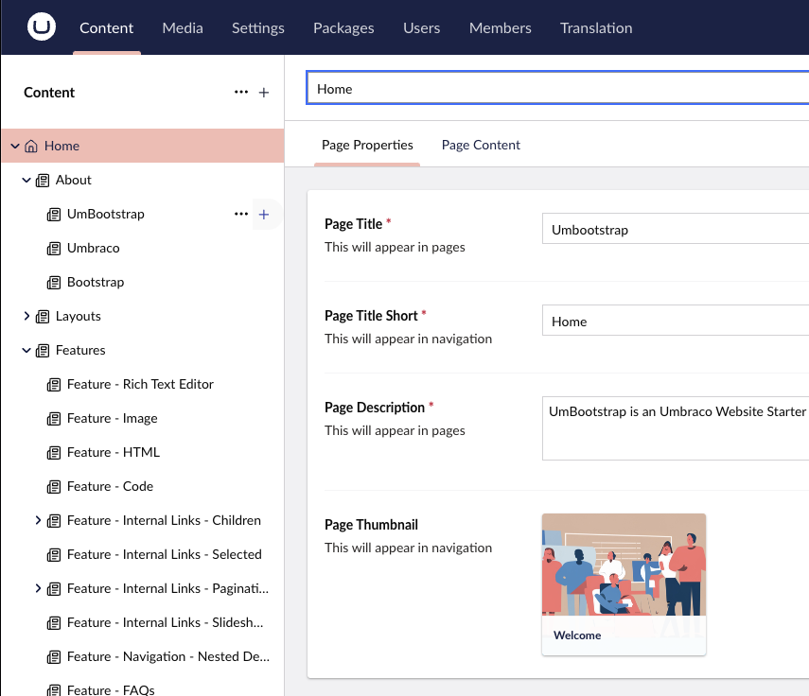
Standard vs long term support
Umbraco has gone under a transformation
Current STS
using modern JS
dotnet 9
Current LTS
dotnet 8
legacy angularJS
wider community support
Notes:
Aligning more and more to MS standards such as Hybrid cache support for EF core

Slide 5

Let’s get going
.NET SDK + Hosting bundle
An editor
A SQL/ SQLite database
SQLite
SQL Server Express LocalDB
SQL Server
Azure SQL

Slide 6
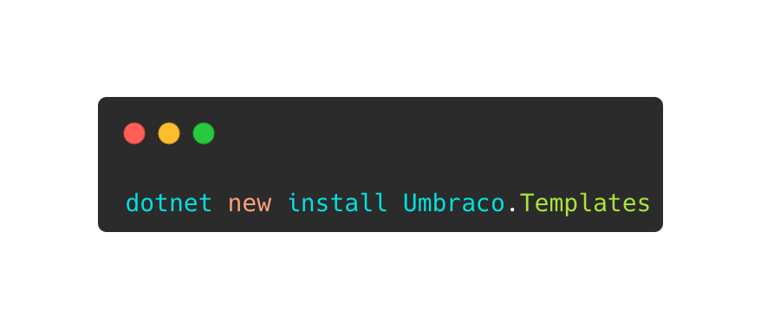

Slide 7
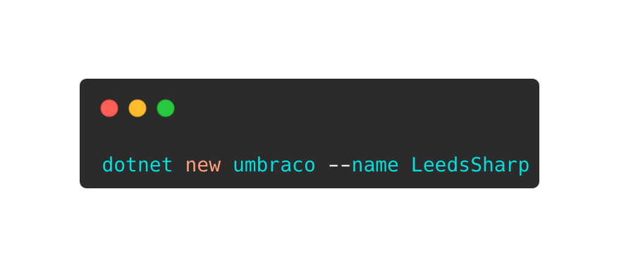

Slide 8
Shout out to Umbootstrap
For saving me a lot of time creating the demo site

Slide 9
To code and the CMS!
My solution has a little bit more than just the template

Slide 10

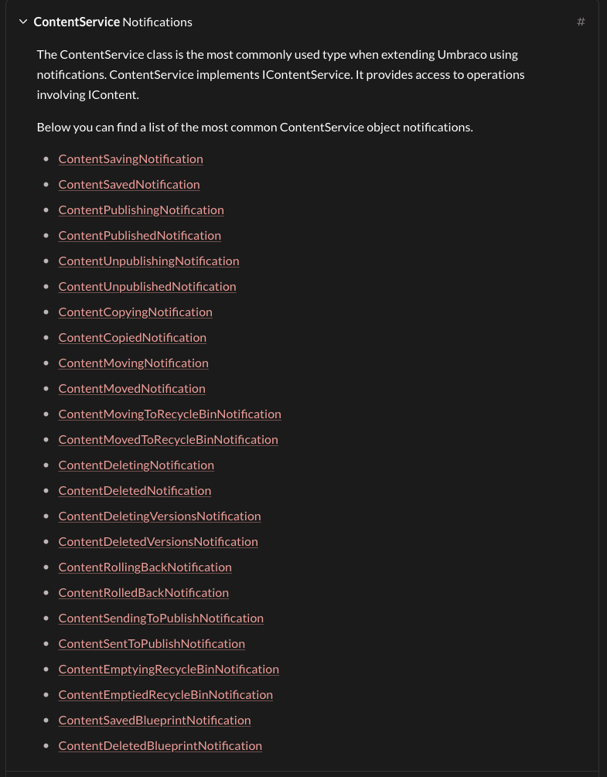

Notifications
From content to cache and beyond

Slide 11

Webhooks
content and media changes
Documentation

Slide 12

Content Delivery API
Fully documented and extendable
Documentation

Slide 13

Load Balancing
Not for the editors yet.
Documentation

Slide 14

Search
Based on Lucene using Examine
Azure search is also an installable option
Documentation

Slide 15

Membership
using ASP.NET Core Identity
Documentation

Slide 16

Single Sign on
Using OAuth
Documentation

Slide 17

Testable
Microsoft Dependency Injection
Documentation

Slide 18

Fully customizable
Everything in the back office can be removed
Documentation

Slide 19

The real heart of Umbraco
Is the community

Slide 20

Where to find them
Discord https://discord.umbraco.com/
Social media (all of them)
Forums -https://forum.umbraco.com/
Relaunched today!

Slide 21
Community tools/Packages
Great things you should know about

Slide 22
uSync
uSync all the things!

Slide 23
Contentment
Most custom properties are covered.
Enum support is a great one for us developers

Slide 24
https://psw.codeshare.co.uk/
Create an install script with all your favourite packages installed

Slide 25
Block Preview
Reuse your Razor views for back office Previews

Slide 26
Umbraco Storage Providers
Adds blob storage/CDN support for media files

Slide 27
Umbraco Forms
A forms builder your editors can use

Slide 28


Umbraco Leeds
Thank you
Github Repo
matthew-wise.bsky.social

